Slide 1
ASP.NET Web API
Lecturer: Ngo Huy Bien
Software Engineering Department
Faculty of Information Technology
VNUHCM - University of Science
Ho Chi Minh City, Vietnam
nhbien@fit.hcmus.edu.vn

Slide 2

Objectives

Slide 3

References
Dino Esposito (2014). Programming Microsoft ASP.NET MVC. Microsoft Press.

Slide 4
What is Web API? [1]
Web API is a well-designed framework for building both RESTful (Representational State Transfer) and remote procedure calls (RPC)–style HTTP services for .NET applications.
Web API intersects various aspects of ASP.NET MVC such as routing, security, controllers, and extensibility and has specific areas not directly supported by plain ASP.NET MVC.

Slide 5
WCF Issues
WCF was initially conceived to support SOAP and WS-* over a wide variety of transportation layers including TCP, Message Queuing (MSMQ), named pipes, and last but not least, HTTP.
Developers were mostly using it as a shortcut to HTTP endpoints.
HTTP facilities on top of WCF didn’t eliminate the true roadblocks that developers were facing such as notorious WCF over-configuration and overuse of attributes, and its structure not being specifically designed for testability.
The key change was separating multitransport services from plain HTTP services and removing all the heavy machinery of WCF to create a thin and HTTP-focused framework for HTTP services. This is Web API.

Slide 6
What Web API means for Client applications
The HTTP protocol seems to be as effective as SOAP but far simpler and subsequently faster.
You can use HTTP verbs and headers to identify operations to perform on remote resources; you can use URL templates to express semantics if you prefer an approach that focuses more on actions.
Either way, you use the body of messages to serialize any input value and receive content.
The JSON format is ideal to serialize objects between clients and HTTP services.

Slide 7
What Web API means for ASP.NET Web Forms applications
This is not to say that in Web Forms you can’t expose HTTP endpoints to be called back from client pages; you can use HTTP handlers or WCF services with freely generated JavaScript proxy classes.
In the end, it works, but coding that is more and more perceived as bothersome.
Web API makes exposing an HTTP service from a Web Forms application as easy as it is to have a controller in ASP.NET MVC: just add a class and it works according to predefined routing rules. Don’t like the default routing rules? Adding your own rules is easy, too!

Slide 8
MVC Controllers vs. Web API
Decoupling code from serialization of results
Content negotiation A new family of components called formatters take care of the serialization of the data being returned to the requesting device.
Hosting outside Internet Information Services (IIS)
Building RESTful applications
Web API doesn’t really add much power to ASP.NET MVC development to be considered a must-have feature.

Slide 9
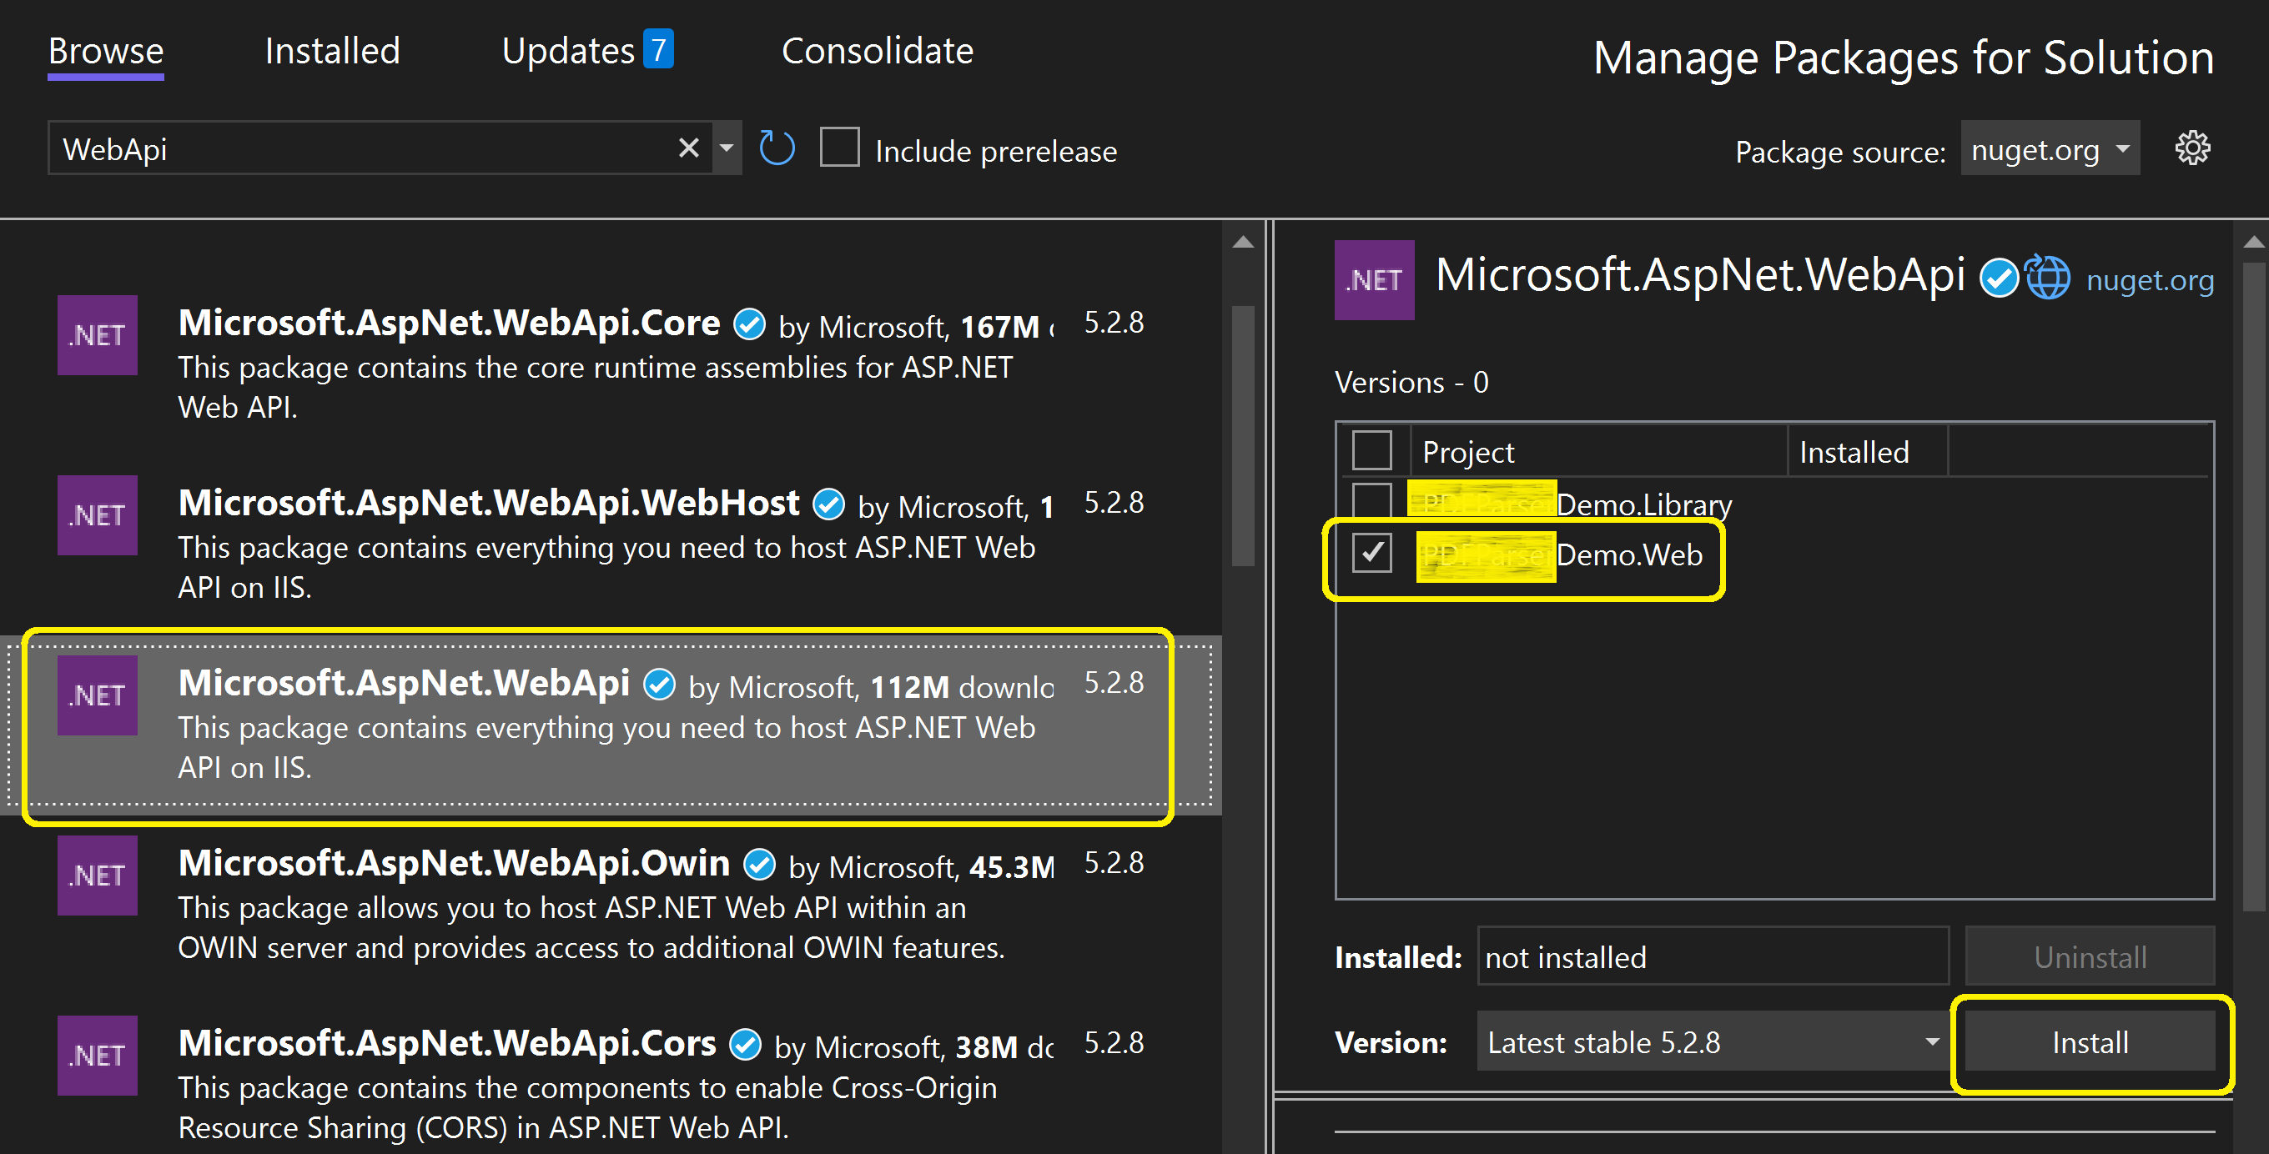
1. Install WebApi Packages

Slide 10
2. Add Route
In Application_Start
private void ConfigureWebAPI()
{
RouteTable.Routes.MapHttpRoute(
name: "WebAPI",
routeTemplate: "api/{controller}/{id}",
defaults: new
{
id = RouteParameter.Optional
}
);
}

Slide 11
3. Create Api Controller
public class PDFParserController: ApiController
{
[HttpGet]
public IHttpActionResult Hello()
{
var helloWorld = "Hello from PDF Parser!";
return Json(new { hello = helloWorld });
}
http://localhost/SWS5/api/PDFParser/
curl -X GET -v http://localhost/SWS5/api/pdfparser

Slide 12
Web API Module
A Web API module is a collection of controller classes that inherit from predefined ApiController.
A Web API module is a stand-alone HTTP-based service that can be hosted by a number of applications, with an ASP.NET MVC application being probably the most common type of host.

Slide 13
Defining the resource type
A resource type is commonly defined as a plain data transfer object (DTO), ultimately a plain C# class.
public class News
{
public String Title { get; set; }
public String Content { get; set; }
public DateTime Published { get; set; }
}

Slide 14
A Controller
public class NewsController : ApiController
{
public IEnumerable<News> GetAll()
{
var url = ...;
var client = new WebClient();
var rss = client.DownloadString(url);
var news = ParseRssInternal(rss);
return news;
}
public News Get(int index)
{
var all = GetAll();
return all[index];
}
...
}

Slide 15
Default Route
When the Web API framework receives an HTTP request, it resolves it in terms of an action method to call on a controller class.
To determine which action to invoke, the Web API framework, similar to classic ASP.NET MVC, uses a routing table.
The WebApiConfig class in the default project template contains the following default route:
public static void Register(HttpConfiguration config)
{
config.Routes.MapHttpRoute(
name: "DefaultApi",
routeTemplate: "api/{controller}/{id}",
defaults: new { id = RouteParameter.Optional }
);
}

Slide 16
Action
Based on the aforementioned NewsController class, a valid URL might be:
http://server/api/news/1
By default, the Web API framework uses the HTTP method to select the action, not the URL. This is just the aspect that gives a touch of RESTfulness to the entire framework.
To find the method, the Web API framework looks for a match on the HTTP method of the request.
With the default route, methods can have an optional trailing parameter named id. The GetAll method has no parameters and thus represents a good match.

Slide 17
Dealing with multiple matches
When this happens, Web API throws an exception internally and the status code received by the caller is HTTP 500 with the JSON error message.

Slide 18

Thank You & See You Again

